Slide 1
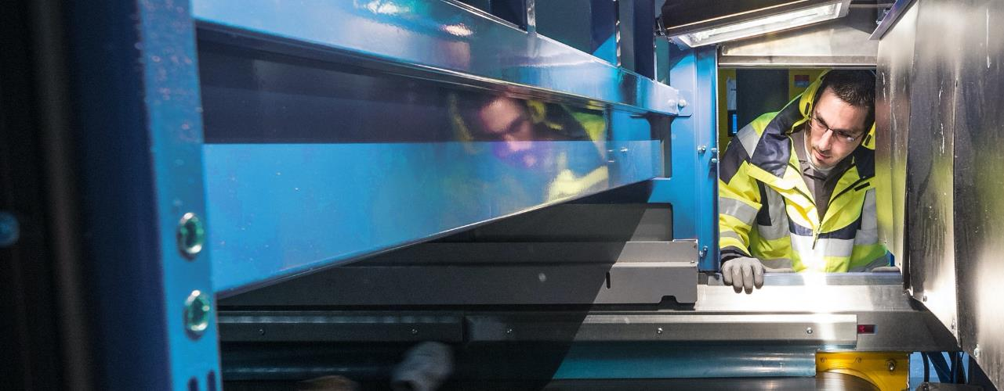
Circular performance partner
TECHNOLOGIES & SERVICES FOR THE CIRCULAR ECONOMY

Slide 2

OUR VISION: the vital transformation of the economy!
Ecological transition is a matter of urgency!
The linear economic model is untenable.
To make the circular economy
a credible solution, it must be made
more widespread,
more competitive
and more sustainable.

Slide 3
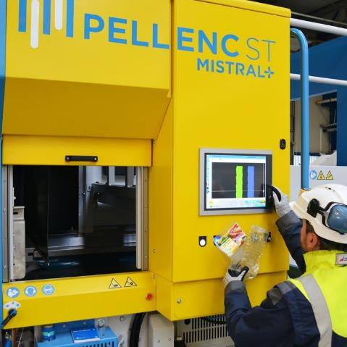
OUR MISSION: making the circular economy a reality
PROFITABILITY
ENVIRONMENT
TECHNOLOGY
We help
improve
operating performance
and the quality of materials
across the entire
value chain.

Slide 4
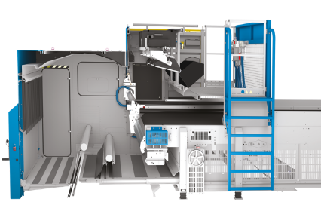

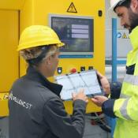


OUR EXPERTISE: combining human intelligence with technology
TECHNOLOGY
Continuous improvement of performance
SERVICE
v
+
Data
collection
Data
analysis
Support for
our customers

Slide 5
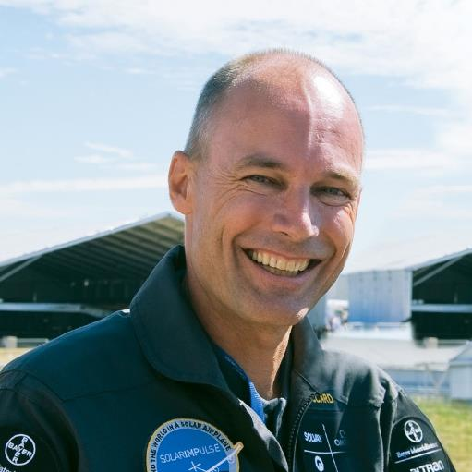
Pellenc ST is constantly evolving as it breaks free of old paradigms. Just like a hot air balloon ride, our teams change altitudes and follow new directions, positioning themselves in the sectors of tomorrow and moving the circular economy forward together.
A pioneering company
Dr Bertrand PICCARD
President of the Solar Impulse Foundation
and sponsor of the We Are 2025 project

Slide 6

In the start-up spirit and a leader already!
A PIONEERING COMPANY
2001
YEAR FOUNDED
15%
AVERAGE ANNUAL GROWTH FOR 6 YEARS
      Leader in France and Japan
      International reach
      Independent company
      Supporting:
      - local authorities,
      - sorting centres and
      - manufacturers
      A SME today,
      a mid-cap tomorrow!
190
EMPLOYEES
x2
AIM TO DOUBLE TURNOVER BY 2025
45
MILLION EUROS
IN TURNOVER
MEMBER OF THE ACCÉLÉRATEUR PME [SME ACCELERATOR] PROGRAMME

Slide 7
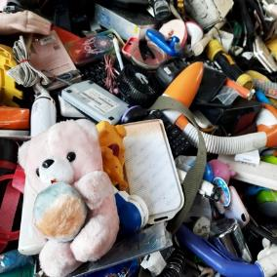


Our offering covers all applications pertaining to local needs
SERVING YOUR REGIONS
WASTE SORTING
Selective collection
OM
DIB
C&D
Wood
Glass, etc.
PLASTICS
RECYCLING
PET
Film
PE/PP
Flakes, etc.
RECYCLING OF METALS
AND OTHER TECHNICAL
PLASTICS
WEEE
Recycling shredded waste
Aluminium, etc.

Slide 8




























They are moving forward, with us:
SERVING YOUR REGIONS
OPERATORS
INTEGRATORS

Slide 9
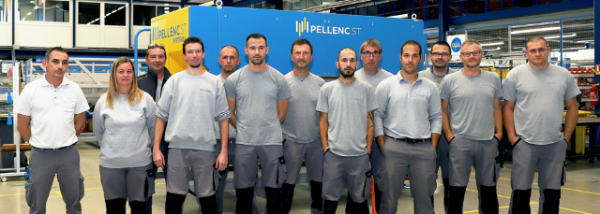
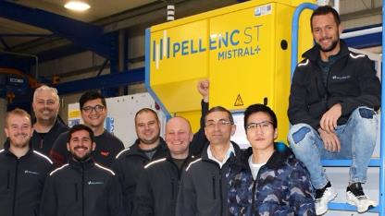
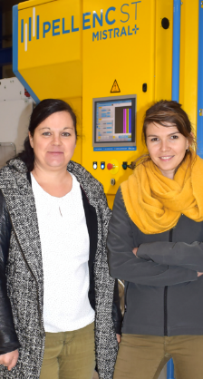
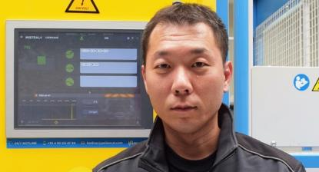

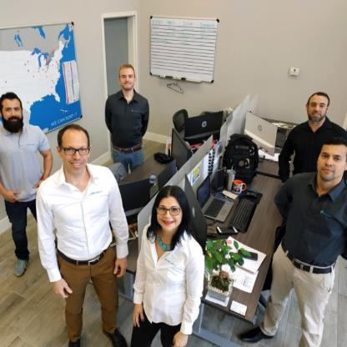


SERVING YOUR REGIONS

